Slide 1
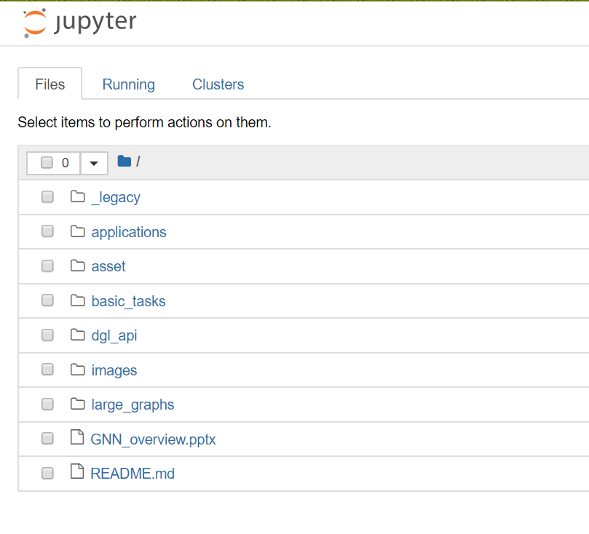
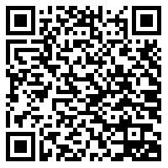
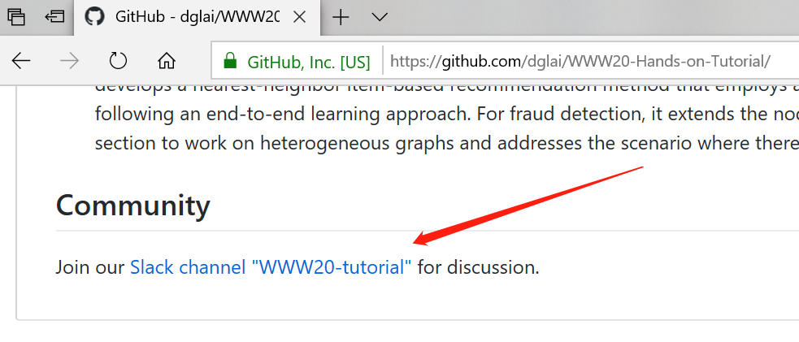
SageMaker Setup Instructions
Send an email to dgl-www20@request-nb.mxnet.io
You will receive two emails. Click the notebook link in the second one.
Need help?
Join our slack channel

Slide 2
Tutorial: Learning Graph Neural Networks with Deep Graph Library
George Karypis, Zheng Zhang, Minjie Wang, Da Zheng, and Quan Gan

Slide 3
Agenda
9:00-9:45 Overview of graph neural networks
9:45-10:30 Overview of deep graph library (DGL)
10:30-11:00 Virtual coffee break
11:00-12:30 (Hands-on) GNN models for basic graph tasks
12:30-14:00 Virtual lunch break
14:00-15:30 (Hands-on) GNN training on large graphs
15:30-16:00 Virtual coffee break
16:00-17:00 (Hands-on) GNN models for real-world applications

Slide 4
Overview of Graph Neural Networks
George Karypis
Senior Principal Scientist, AWS Deep Learning Science, Palo Alto, CA, USA, gkarypis@amazon.com Professor, Department of Computer Science & Engineering, University of Minnesota, Minneapolis, MN, USA, karypis@umn.edu, (on leave)

Slide 5
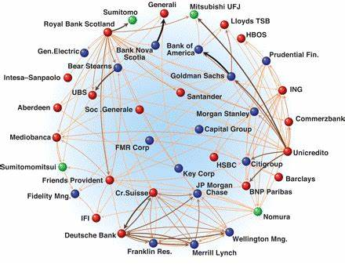
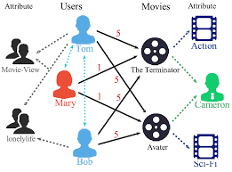
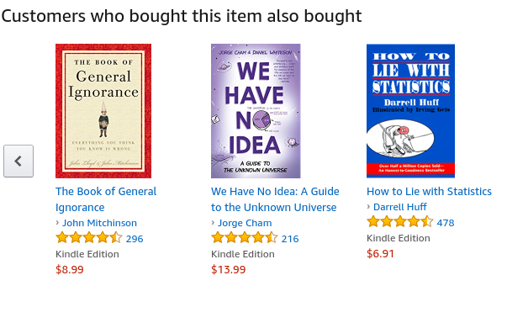
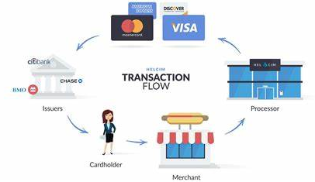
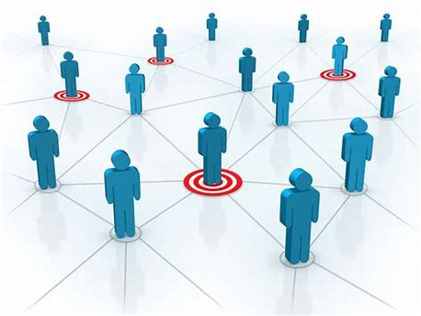
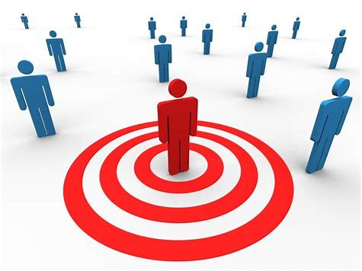
Fraud & Abuse
Recommendations
Detect malicious accounts, fraudulent financial transactions, fake reviews, fraudulent insurance claims, …
Products, media, articles, experiences, jobs, courses, spouses, …
Financial transactions network
Collaborative knowledge graph
Marketing
Who should get a discount? Who are the influencers? Who are the risk of churning?
Social network
Notes:
Graphs are present in many of these applications.

Slide 6
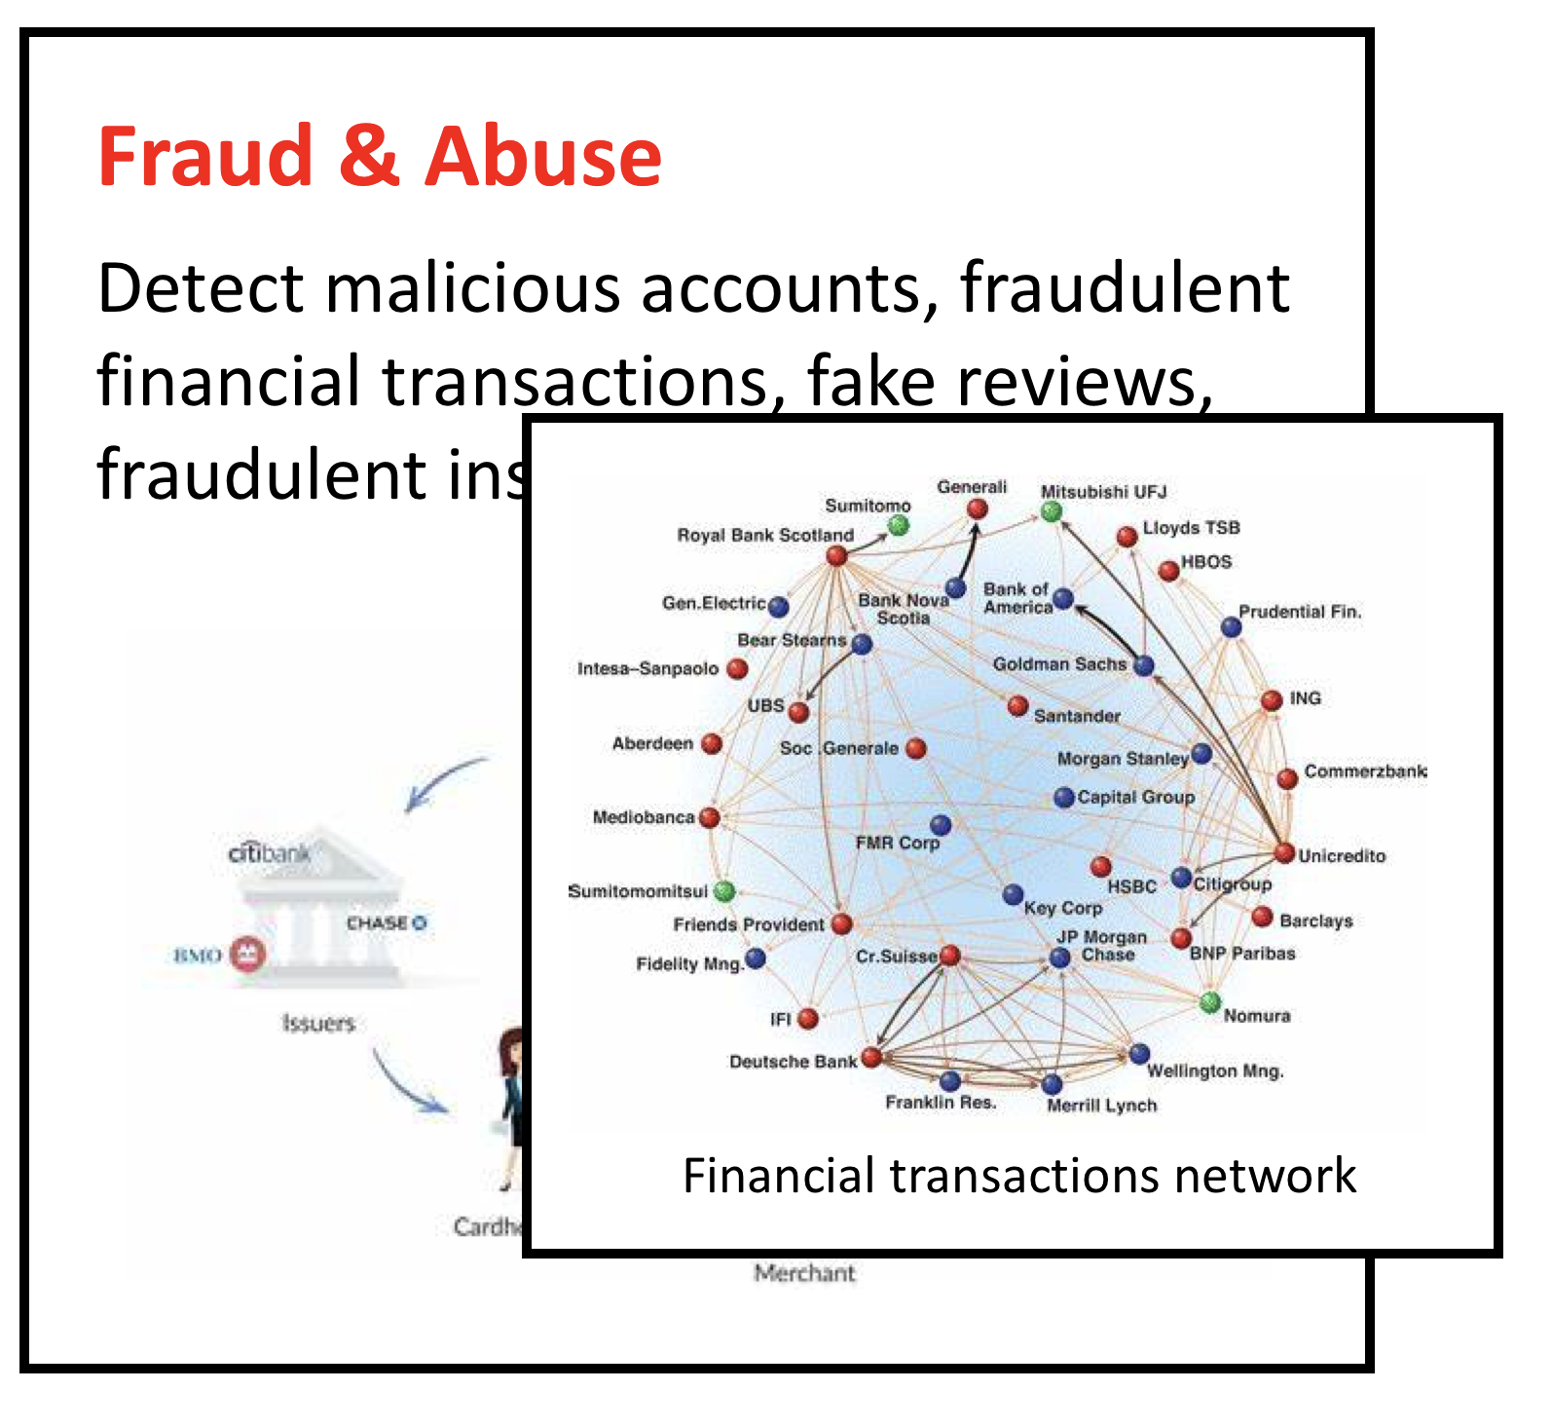
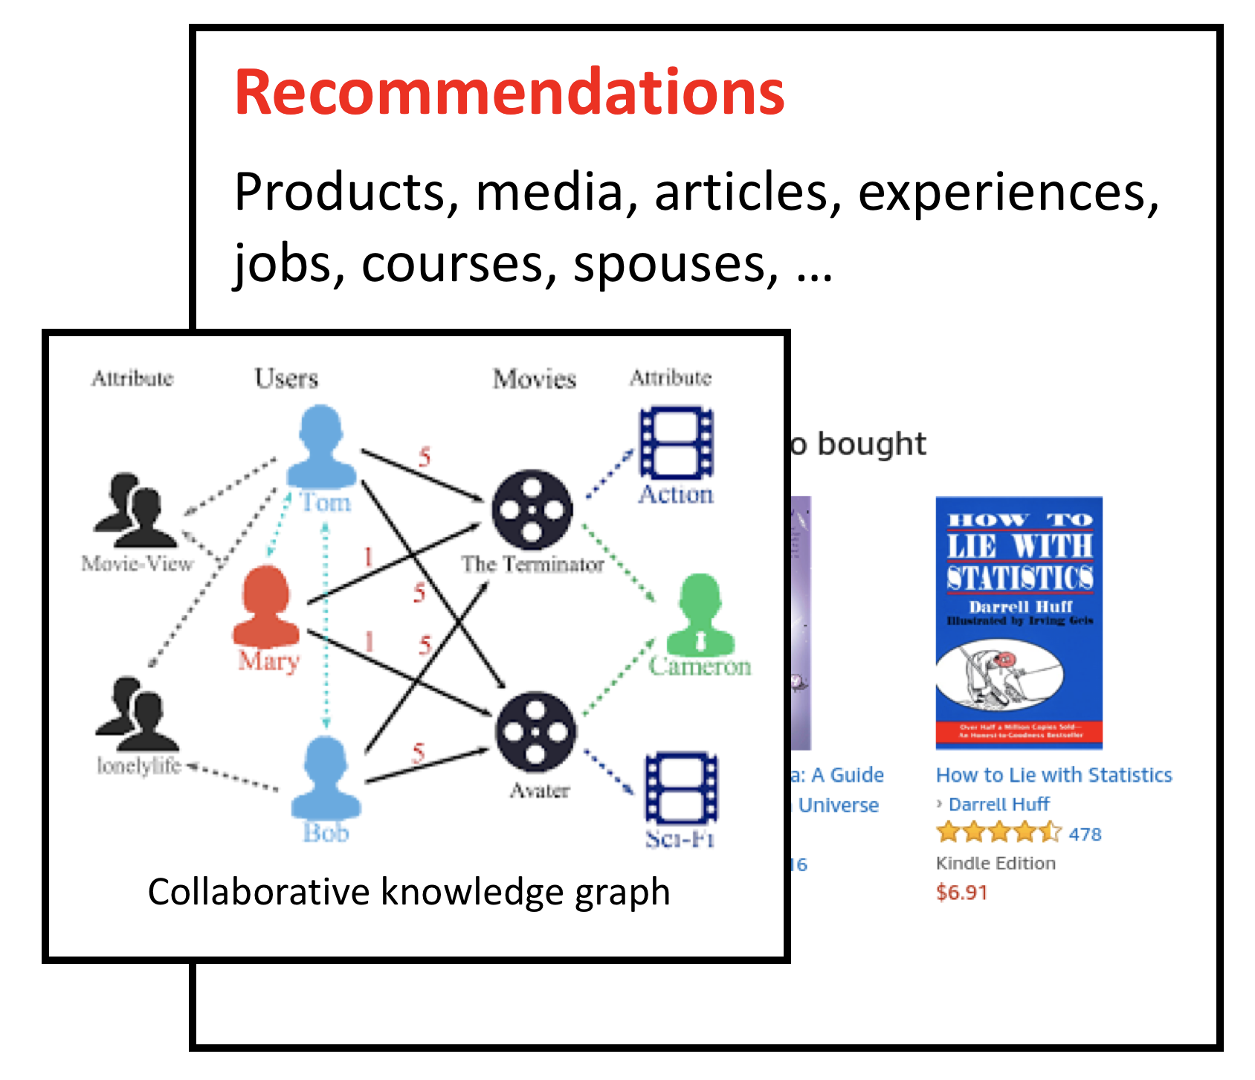
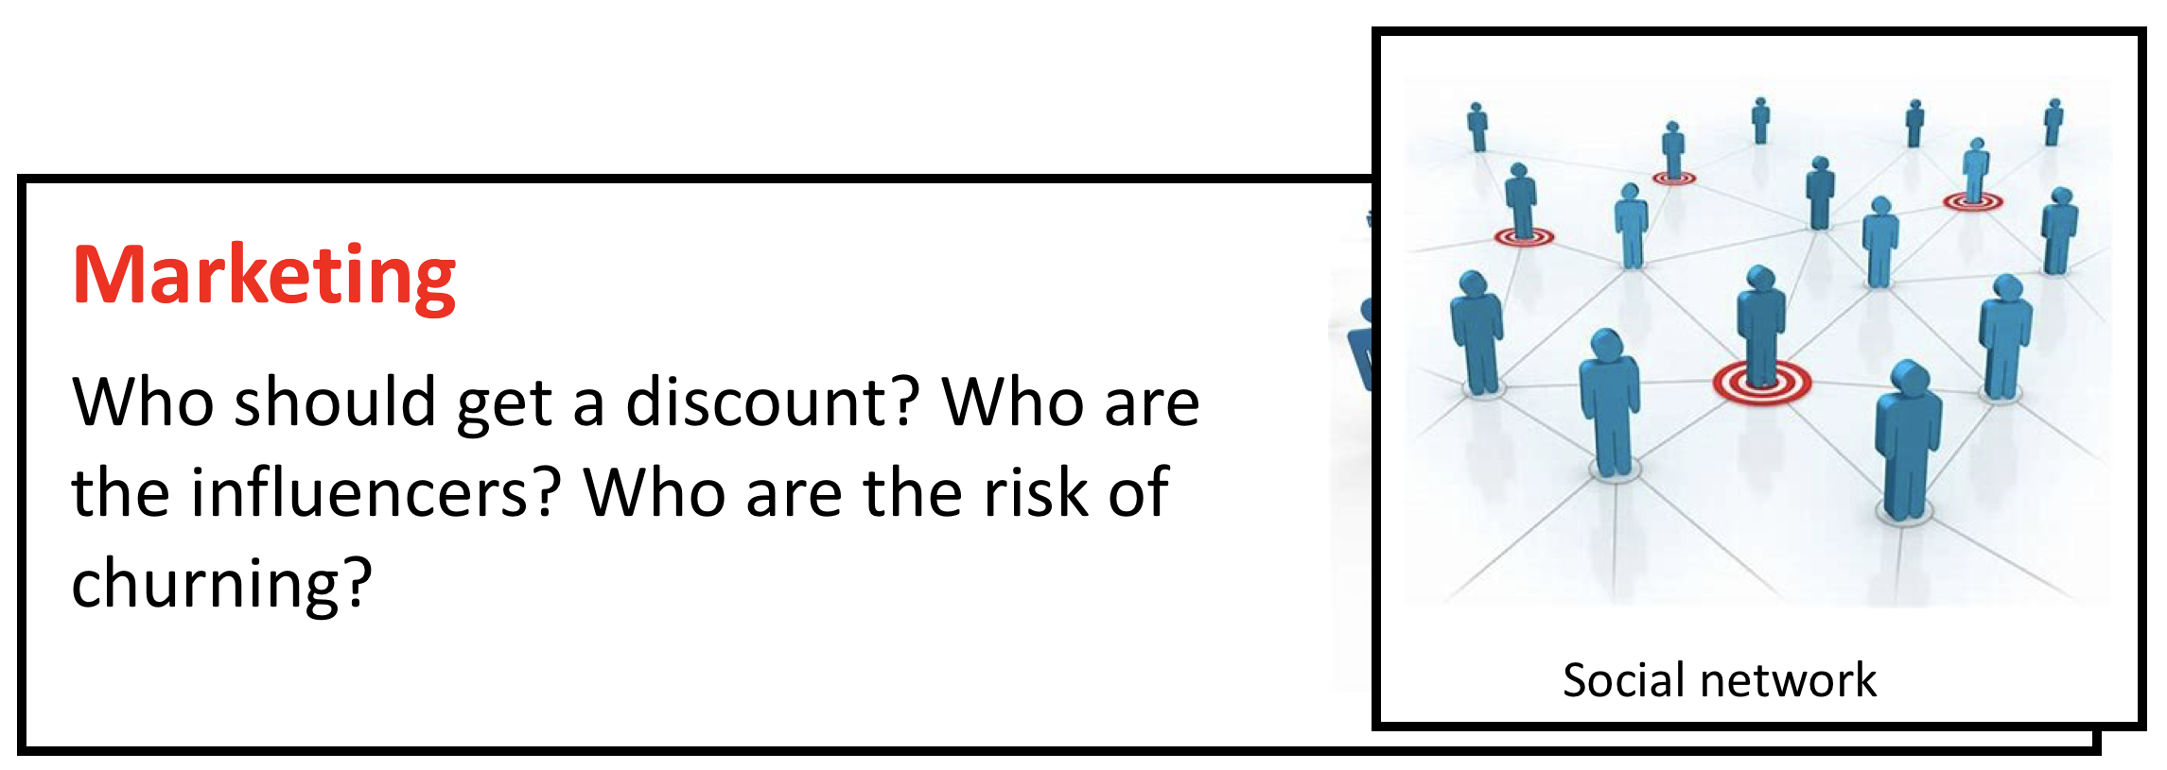
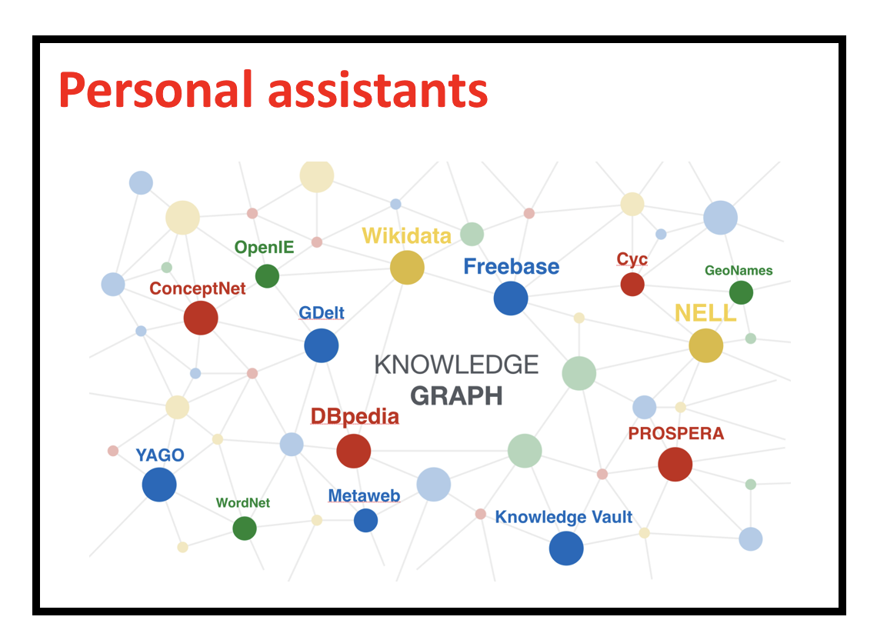
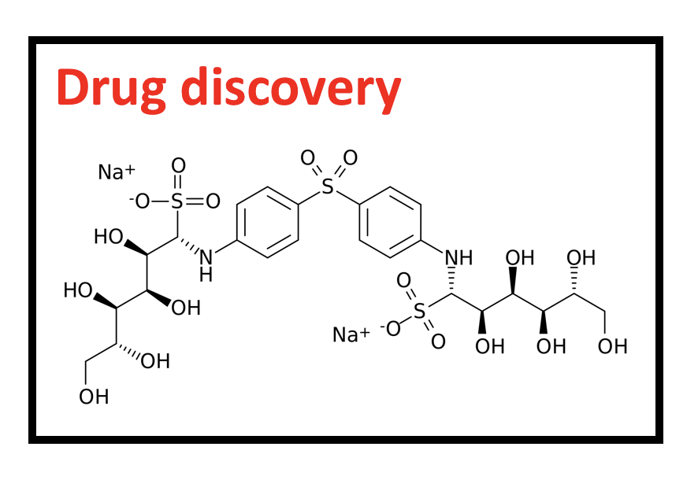
Tasks in graph learning
Node classification
Detect malicious accounts
Target right customers
Link prediction
Recommendations
Predict missing relations in a knowledge graph
Graph classification
Predict the property of a chemical compound

Slide 7
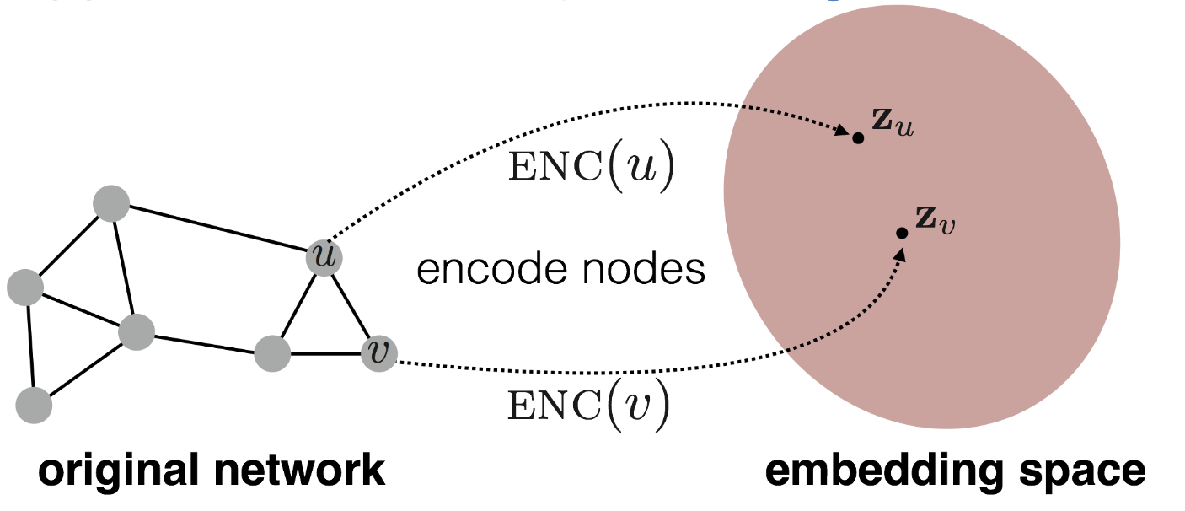
Graph learning and node embeddings
Embed nodes to a low-dimension space so that these embeddings capture the essential task-specific information and use them to train off-the-self classifiers.
For example, node similarities in the embedding space approximates the similarities in the original graph.
Representation Learning on Networks, snap.stanford.edu/proj/embeddings-www, WWW 2018

Slide 8
Traditional graph learning approaches
Generate embeddings by manual feature engineering
Requires domain expertise, involves considerable manual fine-tuning, time consuming, does not scale, …
Automatically generate embeddings using unsupervised dimensionality reduction approaches
Singular value decomposition, tensor decomposition, co-factorization, deep walks, etc.
Cannot effectively combine rich attributes with network structure.
Employ mostly (multi-)liner models.
Do not allow for end-to-end learning.

Slide 9
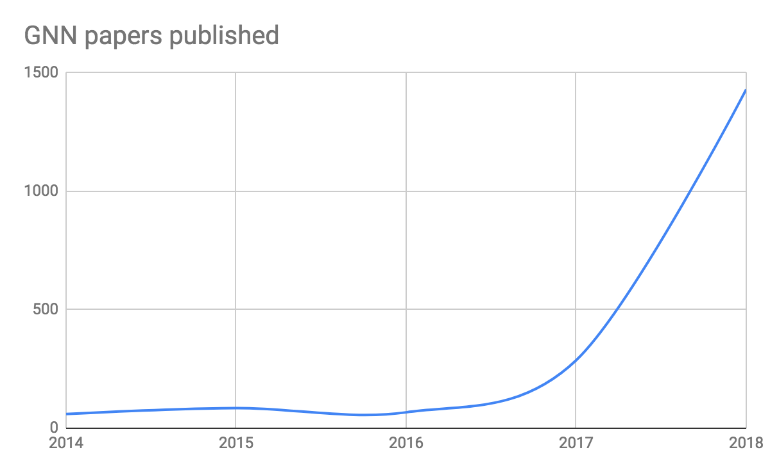
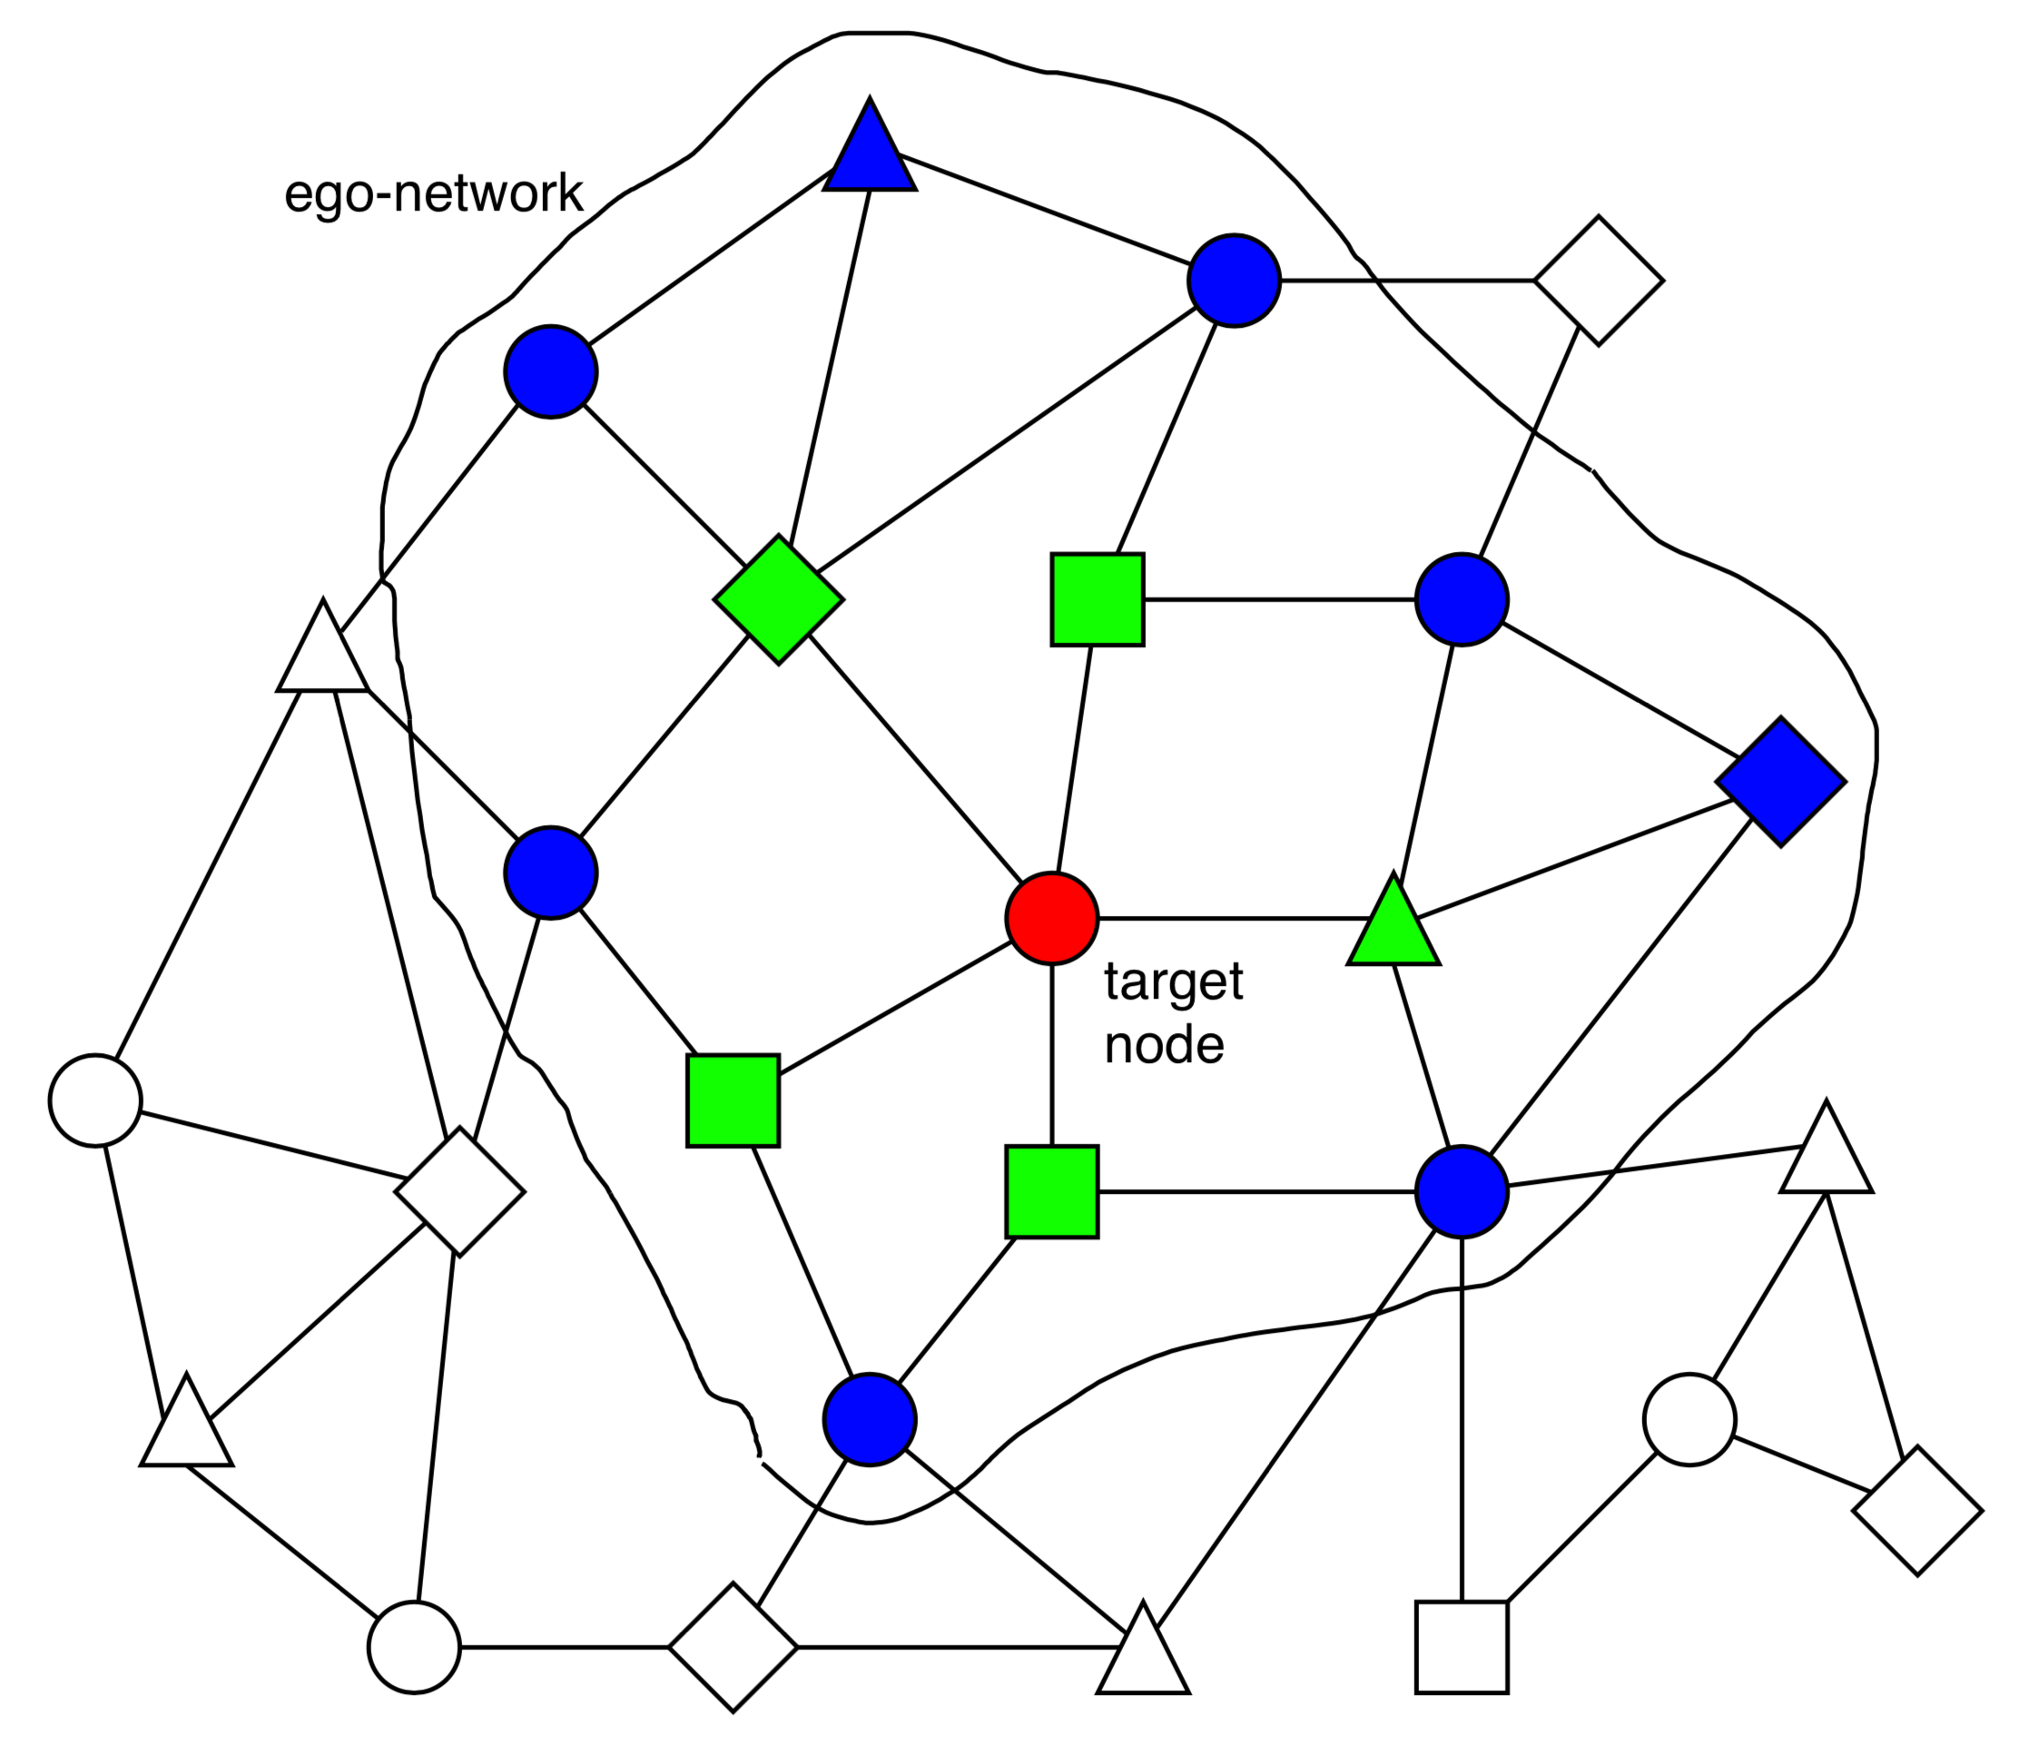
Can we do better?
They are becoming extremely popular.
Graph Neural Network (GNN)
A family of (deep) neural networks that learn node, edge, and graph embeddings.
How do GNNs work?
An ego-network around each node is used to learn an embedding that captures task-specific information.
The embeddings use both the structure of the graph and the features of the nodes and edges.
The embeddings are learned in an end-to-end fashion; thus, the predictions are a function of the target node’s ego-network.

Slide 10
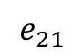
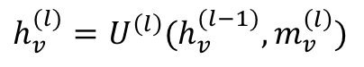
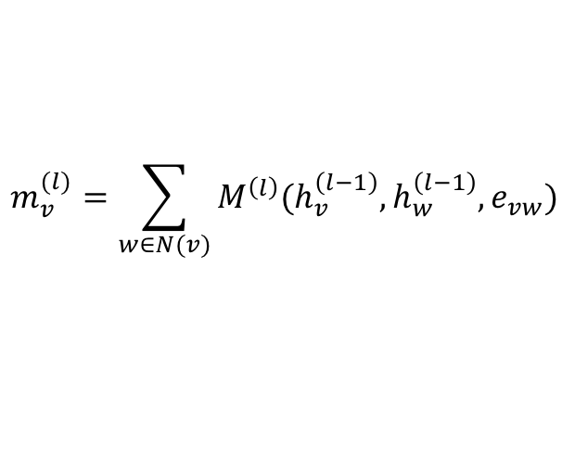
A general graph neural network formalism
Graph neural networks are based on message-passing
Reduce/Aggregate
h₅
Message
h₂
v₅
$$m_{v}^{(l)}=\sum_{w∈N(v)}{M^{\left(l\right)}(h_{v}^{\left(l−1\right)}, h_{w}^{\left(l−1\right)}, e_{vw})}$$
v₂
$$e_{21}$$
v₁
h₁
$$h_{v}^{(l)}=U^{\left(l\right)}(h_{v}^{(l−1)}, m_{v}^{\left(l\right)})$$
Update
v₃
v₄
h₄
h₃
Neural Message Passing for Quantum Chemistry
Notes:
Message: tensor computed from source node/ destination node/ edge features
Reduce: aggregating the messages (and updating the node representation accordingly)

Slide 11
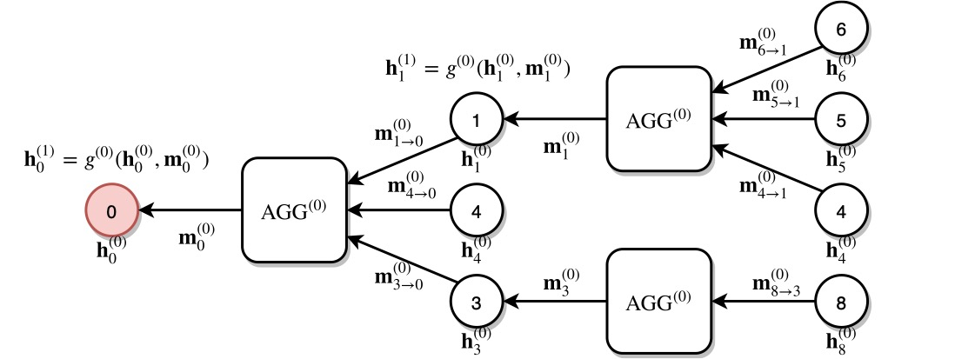
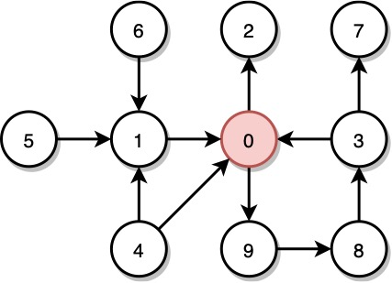
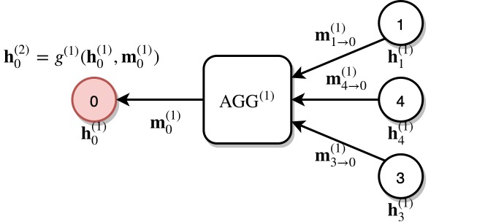
A multi-layer GNN
Multiple GNN layers can be stacked together.
1st layer
2nd layer

Slide 12
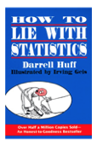
Why are graph neural networks better?
GNNs compute node embeddings using both the structure of the graph and the features of the nodes and edges.
Name: xxx
Age: xxx
Sex: xxx
Title: How to lie with statistics
Author: Darrell Huff
Type: Kindle Edition
Price: $6.91
users
books

Slide 13
Why are graph neural networks better?
GNNs can integrate topologically distant information in a non-linear fashion.
1st layer
2nd layer

Slide 14
Why are graph neural networks better?
GNNs and the downstream classification/regression models can be trained in an end-to-end fashion.
Traditional method
Classifier
GNN
Classifier

Slide 15
Why are graph neural networks better?
GNNs are naturally inductive because they learn the same neural networks on all the nodes and edges.
GNN
GNN

Slide 16
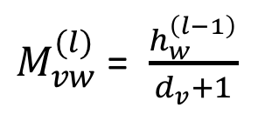
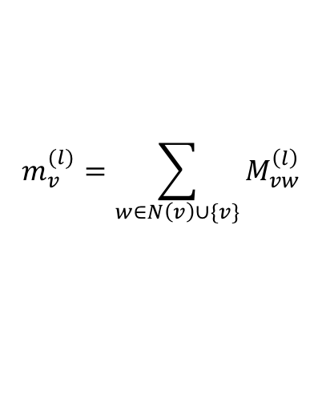
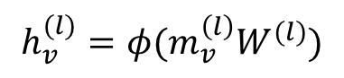
Example 1: Graph convolution network (GCN)
$M_{vw}^{(l)}$= $\frac{h_{w}^{\left(l−1\right)}}{d_{v}+1}$
$$m_{v}^{(l)}=\sum_{w∈N\left(v\right)∪\{v\}}{M_{vw}^{\left(l\right)}}$$
$$h_{v}^{(l)}=φ(m_{v}^{\left(l\right)}W^{(l)})$$

Slide 17
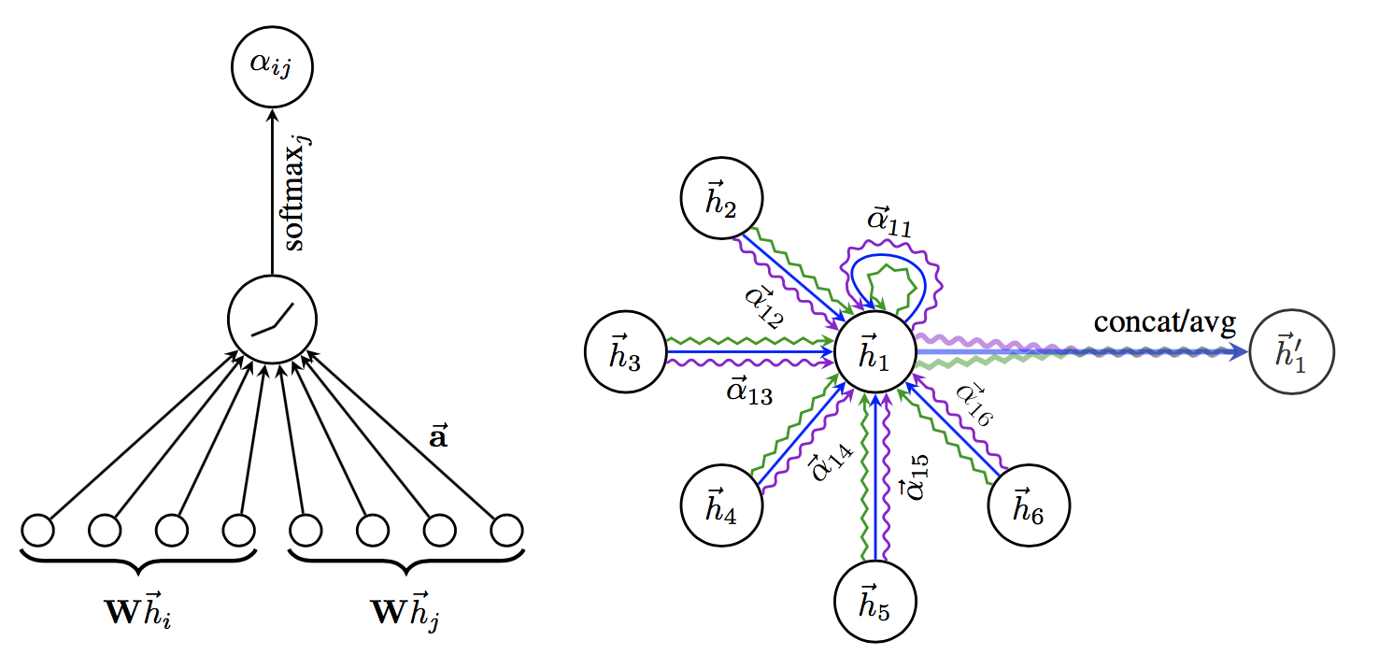
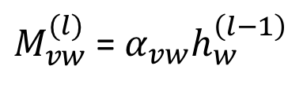
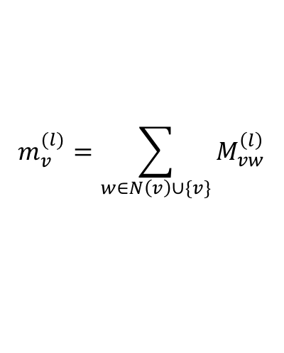
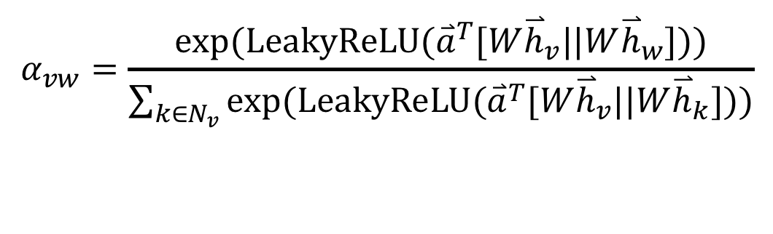
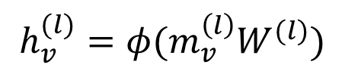
Example 2: Graph attention networks (GAT)
GAT provides weighted sum over the neighborhood—Enables to selectively integrate information.
$M_{vw}^{(l)}$= $α_{vw}h_{w}^{\left(l−1\right)}$
$$m_{v}^{(l)}=\sum_{w∈N\left(v\right)∪\{v\}}{M_{vw}^{\left(l\right)}}$$
$$h_{v}^{(l)}=φ(m_{v}^{\left(l\right)}W^{(l)})$$
$$α_{vw}=\frac{exp⁡(LeakyReLU({\overset{⃑}{a}}^{T}[W{\overset{⃑}{h}}_{v}||W{\overset{⃑}{h}}_{w}]))}{\sum_{k∈N_{v}}{exp⁡(LeakyReLU({\overset{⃑}{a}}^{T}[W{\overset{⃑}{h}}_{v}||W{\overset{⃑}{h}}_{k}]))}}$$

Slide 18
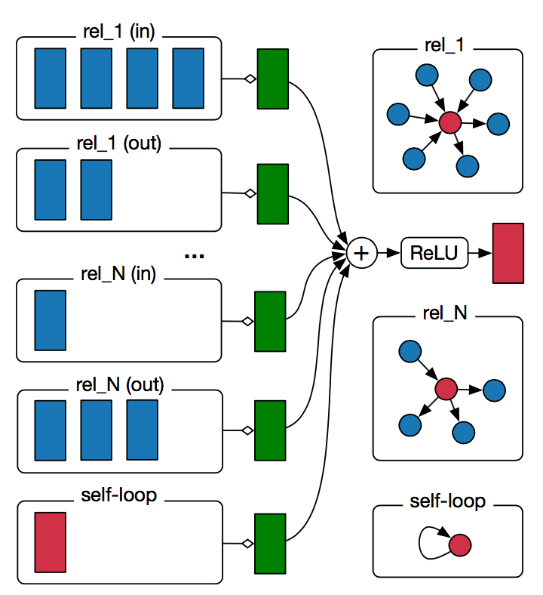
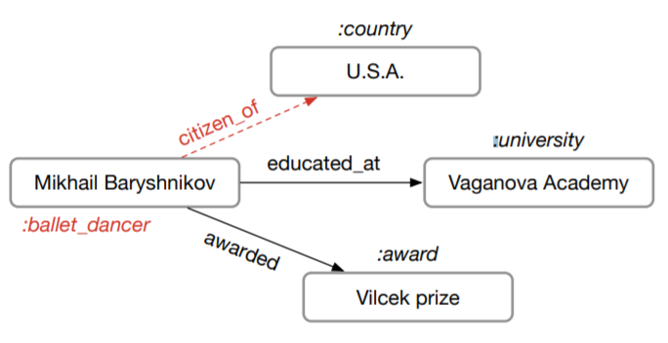
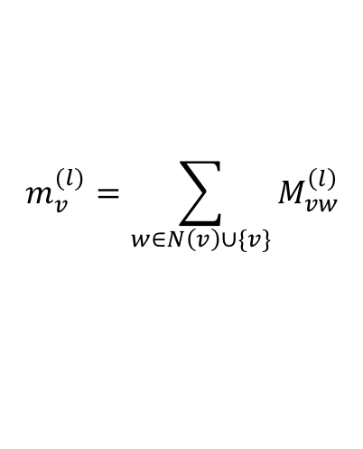
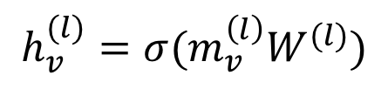
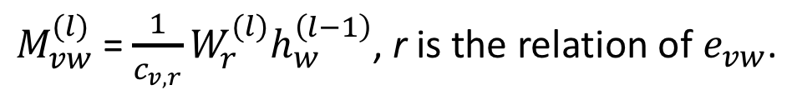
Example 3: Relational graph convolution networks (RGCN)
Handles graphs whose nodes are connected with different relations.
$M_{vw}^{(l)}$= $\frac{1}{c_{v,r}}W_{r}^{(l)}h_{w}^{\left(l−1\right)}$, r is the relation of $e_{vw}$.
$$m_{v}^{(l)}=\sum_{w∈N\left(v\right)∪\{v\}}{M_{vw}^{\left(l\right)}}$$
$$h_{v}^{(l)}=σ(m_{v}^{\left(l\right)}W^{(l)})$$

Slide 19
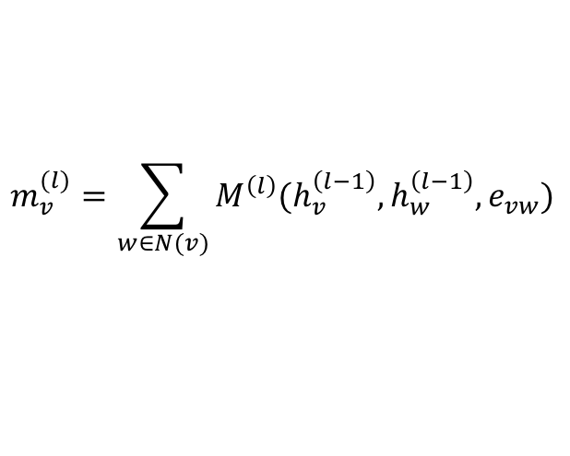
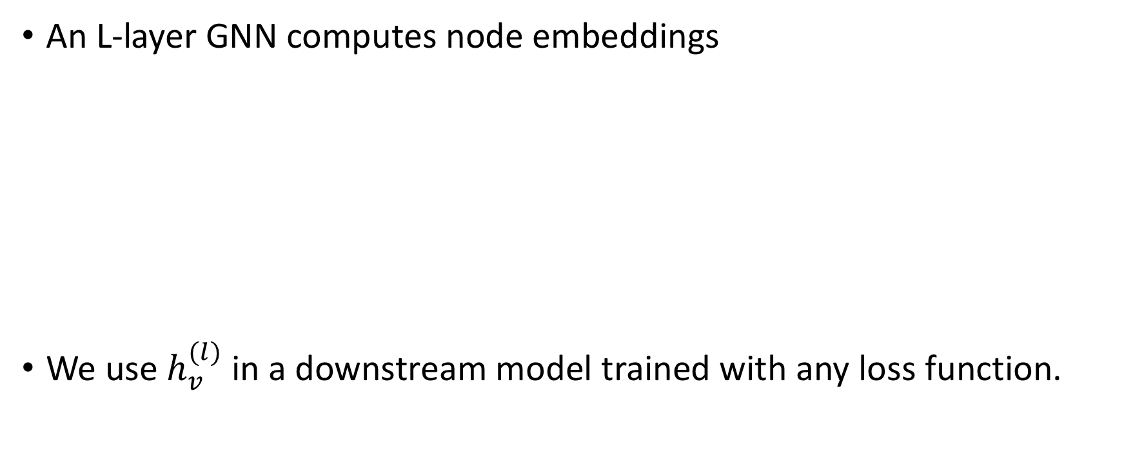
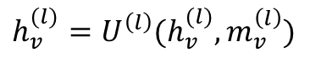
How to train an end-to-end GNN?
An L-layer GNN computes node embeddings
We use $h_{v}^{(l)}$ in a downstream model trained with any loss function.
$$m_{v}^{(l)}=\sum_{w∈N(v)}{M^{\left(l\right)}(h_{v}^{\left(l−1\right)}, h_{w}^{\left(l−1\right)}, e_{vw})}$$
$$h_{v}^{(l)}=U^{\left(l\right)}(h_{v}^{(l)}, m_{v}^{\left(l\right)})$$

Slide 20
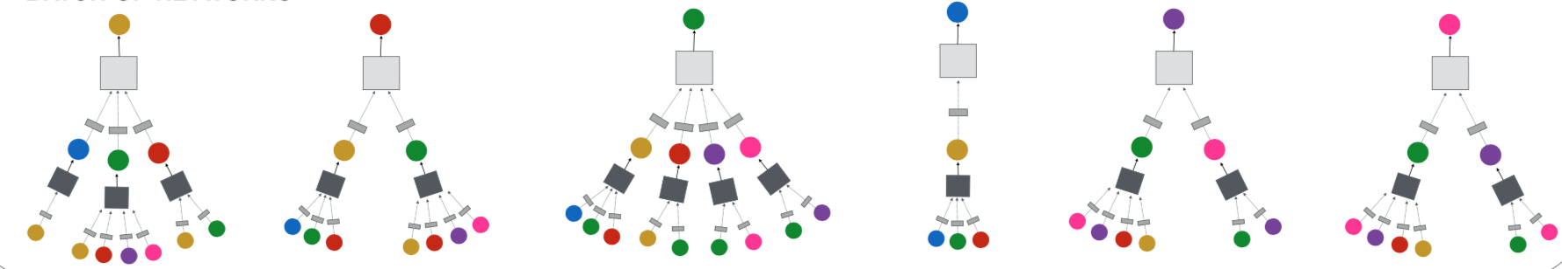
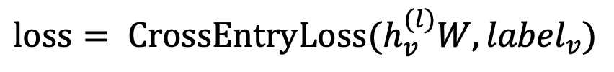
Node classification with GNN
Node classification is trained in the semi-supervised setting.
$$loss= {CrossEntryLoss(h}_{v}^{(l)}W, {label}_{v})$$
0
1
0
?
?
?

Slide 21
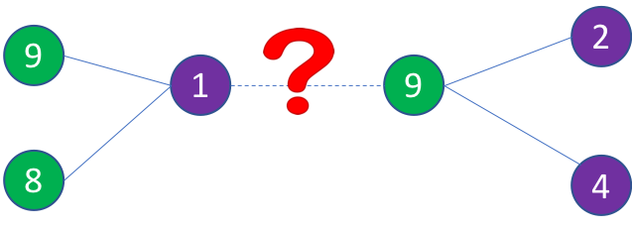
Link prediction with GNN
We train a link prediction model with connectivity of nodes as the training signal.
Positive edges are trained against a few negative edges
${loss= −log (σ⁡(h}_{v}^{T}h_{w}))−Q∙E_{u_{n}\sim P_{n}(v)}{log (σ⁡(−h}_{v}^{T}h_{u_{n}})$)
Positive edges
Negative edges
Graph convolution to
encode node embeddings
Graph convolution to
encode node embeddings

Slide 22
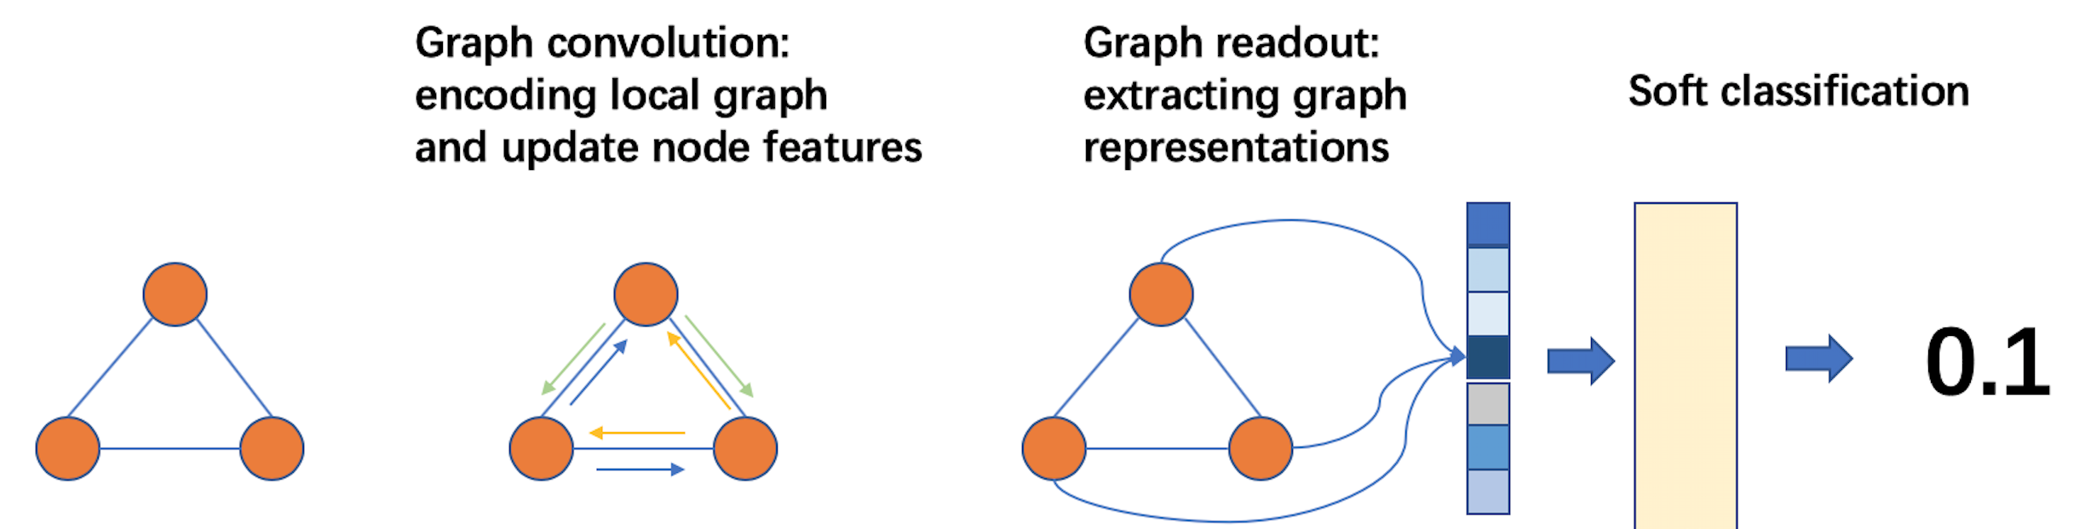
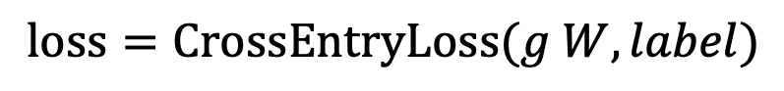
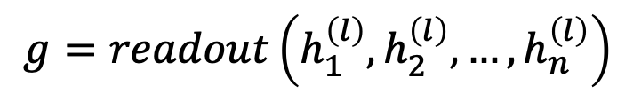
Graph classification
Graph readout to compute graph embeddings.
Train a graph classifier on the graph embedding.
$$g=readout\left(h_{1}^{\left(l\right)},h_{2}^{\left(l\right)}, …,h_{n}^{\left(l\right)}\right)$$
$$loss=CrossEntryLoss(g W, label)$$

Slide 23
How to train GNN on large graphs
Many applications have extremely large graphs—millions of nodes and billions of edges:
Social networks
Recommendation
Knowledge graph
…
A typical training method: mini-batch training

Slide 24
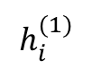
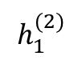
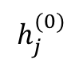
A glance of mini-batch training on graphs
A mini batch represents the computation graph for target nodes.
Small-world graphs lead to a huge computation graph.
2
3
$$h_{1}^{(2)}$$
1
1
10
5
$$h_{i}^{(1)}$$
2
3
4
5
6
9
4
6
8
7
$$h_{j}^{(0)}$$
1
3
4
6
7
8
9
10
11
11

Slide 25
Mini-batch with neighbor sampling
Prune the computation graph:
Sample neighbors from a neighbor list of a vertex.
1
1
2
3
4
5
6
2
4
1
7
8
1
3
4
6
7
8
9
10
11

Slide 26
Summary
The solution to many applications can be formulated as graphlearning problems.
Graph neural networks are a new technique for graph learning.
They have multiple advantages over traditional methods.
We demonstrate how GNNs are used in multiple graph tasks and how these GNN models can be trained.

